Slide 1
Conjoint Analysis

Slide 2
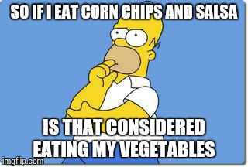

Slide 3
Why Conjoint Analysis?
Asking direct questions about preferences often leads to unenlightening answers.
What load would you like to pay on your mutual fund?
What annual fee would you like?
Would you like online access to your funds?
Consumers want everything and they want it for free!

Slide 4
What should Portland Trailblazers do?
Bus Obj:
Constraints:
Options:

Slide 5
What is the most important Attribute for Customers?
Seat Location =
Number of Games =
Ticket Price =
Promotional Item =

Slide 6
Can Portland Raise Ticket Prices?
Utility of Current Ticket Prices and Locations:
300 bb + $15 =
300 c + $25 =
300 M + $35 =
200 M + $60 =
300M + $60 =

Slide 7
Utility Buffer= .27 = (.28-.01)
What price increase leads to a decrease in utility by .27?
Difference in utility between $60 and $35 = 1.12 = .126-(-1.00)
How much is the value of a single utility point?
(60-35)/1.12= 22.15
Price increase = .27*22.15 = 6.08

Slide 8
Utility Buffer =
.28 (current utility of 300M) -.01 (current utility of 200 M) = .27
For $25 (between $60 and $35), range in utility -> 1.12
% of utility drop allowed = .27/1.12 = 24%
$ range for 1.12 drop = $25
Allowed price increase = 24%*$25 = $6
Is this gap .27?
$35
$60
.12
-1
1.12

Slide 9
Can Portland Raise Ticket Prices?
Utility of Current Ticket Prices and Locations:
300bb + $15 = -.07523=-.73+.65
300C + $25 = -.21705
300M + $35 = .28336
200M + $60 =.00891
300M + $60 = -.843

Slide 10
What about the promotions?
What is the Willingness to pay for hot dogs?
Compare it with the no promotions offer
https://docs.google.com/presentation/d/1uc3GfMYKuzgjYfPILK6ql05FpU8F5Z1rTjsIb-7CGUs/edit?usp=sharing

Slide 11
Difference between ticket Price utilities =
Price for a utility point =
Difference between Hot Dog and no promotion =
Price for a hot dog =
Profit from hot dog=

Slide 12
Value of hot dog
Utility of hot dog relative to no promotion =
Range of prices =
Range of price utilities =
% of utility available to give =
Increase price by ----- of ---- =
$15
$60
.65
-1
1.65

Slide 13
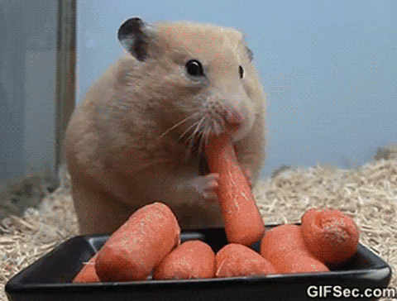

Slide 14
Where can we apply conjoint?

Slide 15
What are the risks and assumptions?

Slide 16
What are the risks/assumptions?

Slide 17
Takeaways

Slide 18
takeaways

